Slide 1

307307 Part 2 – Introduction to Large Language Models

Slide 2
Introduction to Neural Networks
The Perceptron

Slide 3
Objectives
Understand the biological inspiration for neural networks
Learn about the perceptron model
Implement a simple perceptron in Python
Explore activation functions

Slide 4
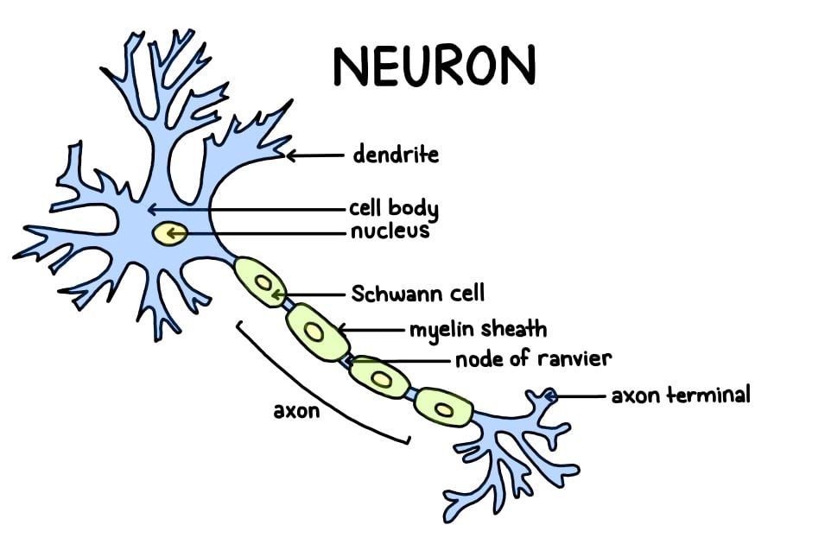
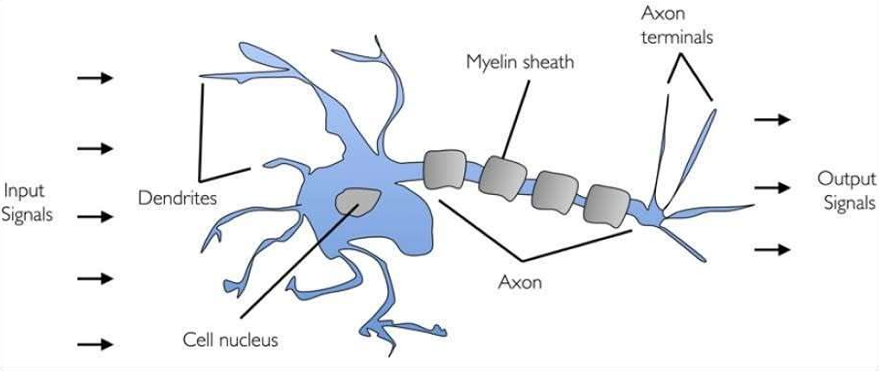
Biological Neuron
Artificial neural networks are inspired by the human brain
Neurons receive signals through dendrites
When input exceeds a threshold, neuron "fires" through the axon
Synapses connect neurons and modulate signal strength

Slide 5
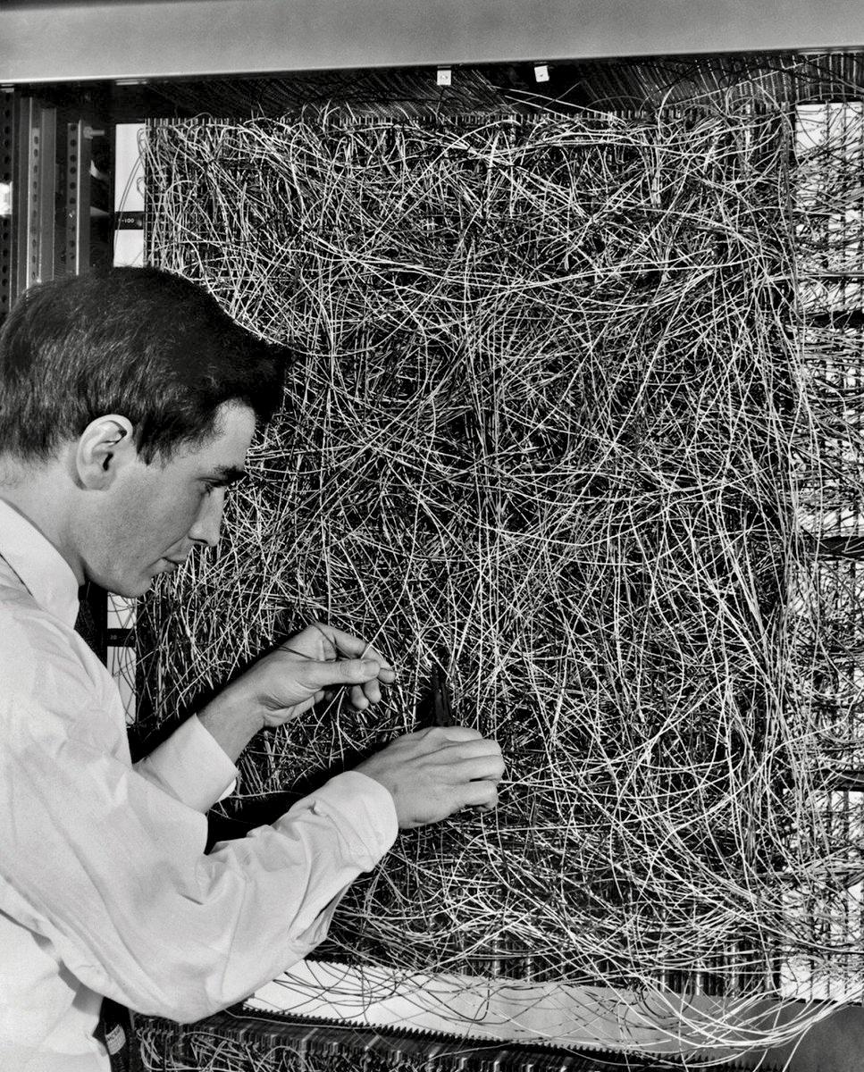
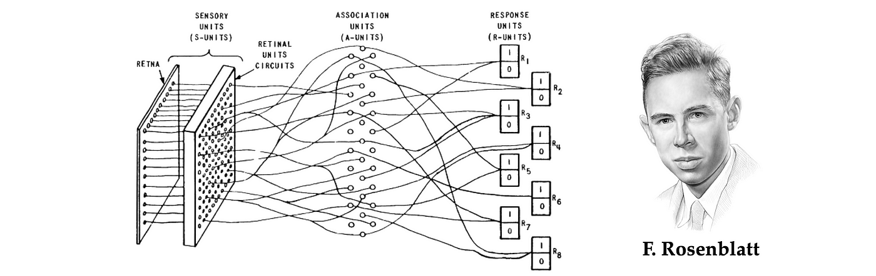
The Perceptron: Building Block of Neural Networks
Invented by Frank Rosenblatt in 1958
Simplest form of a neural network
Binary classifier: separates data into two categories
Models a single neuron with multiple inputs and one output

Slide 6
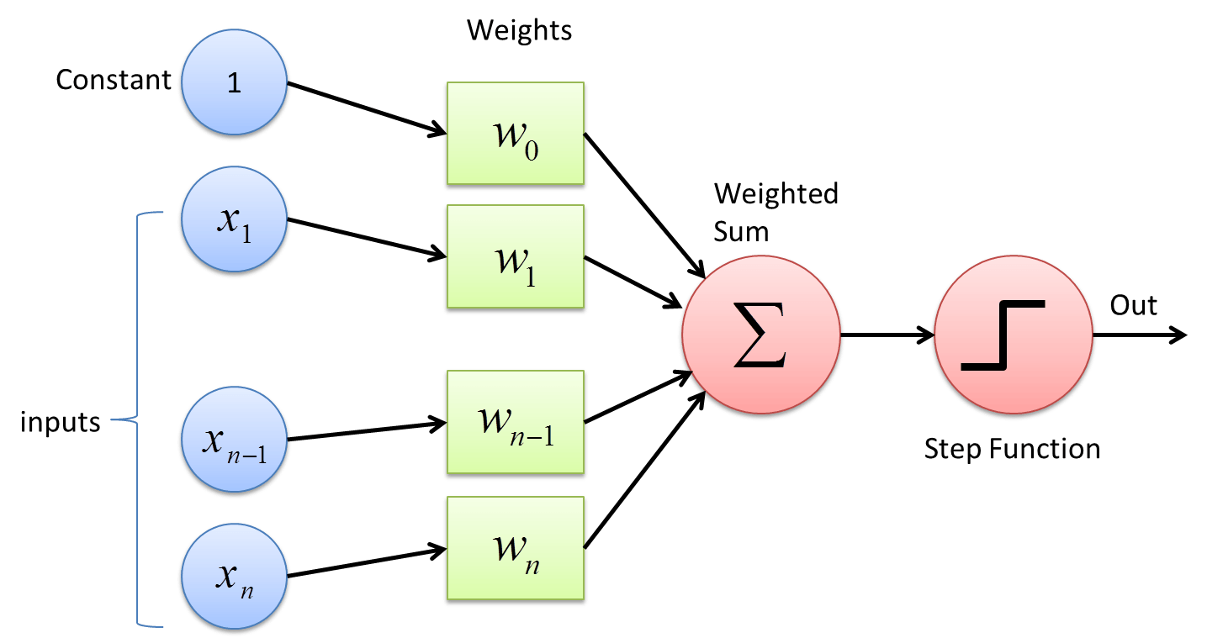
The Perceptron
Inputs: x₁, x₂, ..., xₙ
Weights: w₁, w₂, ..., wₙ
Bias: b
Activation function: Step function
Output: 1 if weighted sum > threshold, 0 otherwise

Slide 7
How a Perceptron Works
Multiply each input by its corresponding weight
Sum all weighted inputs
Add the bias term
Apply the activation function
Output the result
Mathematically:
z = w₁x₁ + w₂x₂ + ... + wₙxₙ + b
output = activation(z)

Slide 8
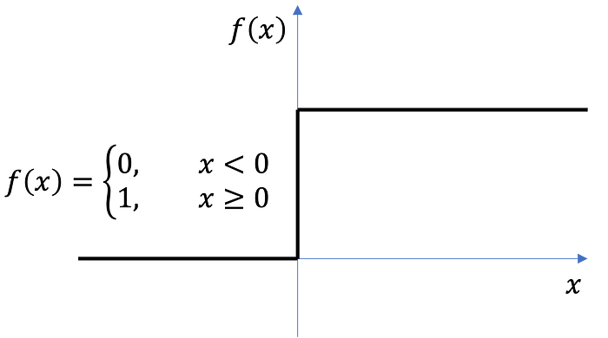
Perceptron Activation Function
Step Function:
Output: 1 if z ≥ 0, 0 if z < 0
Used in original perceptrons
Not differentiable at 0

Slide 9
Perceptron Learning Rule
For each training example:
Calculate predicted output y_pred
Calculate error: error = y_true - y_pred
Update weights: w_new = w_old + learning_rate * error * x
Update bias: b_new = b_old + learning_rate * error

Slide 10
Step-by-Step Hand Calculation for AND Gate
Let's work through the perceptron learning algorithm by hand for the AND gate:
Training data: X = [[0,0], [0,1], [1,0], [1,1]], y = [0, 0, 0, 1]
Learning rate (η) = 0.1
Initial weights (randomly assigned): w₁ = 0.3, w₂ = -0.1
Initial bias: b = 0.2
First Iteration:
Example 1: (0,0) → 0
Inputs: x₁ = 0, x₂ = 0
Weighted sum: z = w₁x₁ + w₂x₂ + b = 0.3(0) + (-0.1)(0) + 0.2 = 0.2
Activation: output = 1 (since z > 0)
True output: y = 0
Error: error = y - output = 0 - 1 = -1
Weight updates:
w₁ = w₁ + η * error * x₁ = 0.3 + 0.1 * (-1) * 0 = 0.3
w₂ = w₂ + η * error * x₂ = -0.1 + 0.1 * (-1) * 0 = -0.1
b = b + η * error = 0.2 + 0.1 * (-1) = 0.1

Slide 11
Step-by-Step Hand Calculation for AND Gate
Example 2: (0,1) → 0
Inputs: x₁ = 0, x₂ = 1
Weighted sum: z = w₁x₁ + w₂x₂ + b = 0.3(0) + (-0.1)(1) + 0.1 = 0
Activation: output = 1 (since z ≥ 0)
True output: y = 0
Error: error = y - output = 0 - 1 = -1
Weight updates:
w₁ = w₁ + η * error * x₁ = 0.3 + 0.1 * (-1) * 0 = 0.3
w₂ = w₂ + η * error * x₂ = -0.1 + 0.1 * (-1) * 1 = -0.2
b = b + η * error = 0.1 + 0.1 * (-1) = 0
Example 3: (1,0) → 0
Inputs: x₁ = 1, x₂ = 0
Weighted sum: z = w₁x₁ + w₂x₂ + b = 0.3(1) + (-0.2)(0) + 0 = 0.3
Activation: output = 1 (since z > 0)
True output: y = 0
Error: error = y - output = 0 - 1 = -1
Weight updates:
w₁ = w₁ + η * error * x₁ = 0.3 + 0.1 * (-1) * 1 = 0.2
w₂ = w₂ + η * error * x₂ = -0.2 + 0.1 * (-1) * 0 = -0.2
b = b + η * error = 0 + 0.1 * (-1) = -0.1

Slide 12
Step-by-Step Hand Calculation for AND Gate
Example 4: (1,1) → 1
Inputs: x₁ = 1, x₂ = 1
Weighted sum: z = w₁x₁ + w₂x₂ + b = 0.2(1) + (-0.2)(1) + (-0.1) = -0.1
Activation: output = 0 (since z < 0)
True output: y = 1
Error: error = y - output = 1 - 0 = 1
Weight updates:
w₁ = w₁ + η * error * x₁ = 0.2 + 0.1 * 1 * 1 = 0.3
w₂ = w₂ + η * error * x₂ = -0.2 + 0.1 * 1 * 1 = -0.1
b = b + η * error = -0.1 + 0.1 * 1 = 0
End of Iteration 1:
Updated weights: w₁ = 0.3, w₂ = -0.1
Updated bias: b = 0

Slide 13
Second Iteration
Example 1: (0,0) → 0
Inputs: x₁ = 0, x₂ = 0
Weighted sum: z = w₁x₁ + w₂x₂ + b = 0.3(0) + (-0.1)(0) + 0 = 0
Activation: output = 1 (since z ≥ 0)
True output: y = 0
Error: error = y - output = 0 - 1 = -1
Weight updates:
w₁ = w₁ + η * error * x₁ = 0.3 + 0.1 * (-1) * 0 = 0.3
w₂ = w₂ + η * error * x₂ = -0.1 + 0.1 * (-1) * 0 = -0.1
b = b + η * error = 0 + 0.1 * (-1) = -0.1
Example 2: (0,1) → 0
Inputs: x₁ = 0, x₂ = 1
Weighted sum: z = w₁x₁ + w₂x₂ + b = 0.3(0) + (-0.1)(1) + (-0.1) = -0.2
Activation: output = 0 (since z < 0)
True output: y = 0
Error: error = y - output = 0 - 0 = 0
Weight updates (no change as error = 0):
w₁ = 0.3
w₂ = -0.1
b = -0.1
After several iterations, the perceptron will converge to weights that correctly classify all AND gate examples.

Slide 14
Python Implementation Perceptron from Scratch
import numpy as np
class Perceptron:
def __init__(self, learning_rate=0.01, n_iterations=1000):
self.learning_rate = learning_rate
self.n_iterations = n_iterations
self.weights = None
self.bias = None
def fit(self, X, y):
# Initialize parameters
n_samples, n_features = X.shape
self.weights = np.zeros(n_features)
self.bias = 0
# Learning
for _ in range(self.n_iterations):
for idx, x_i in enumerate(X):
linear_output = np.dot(x_i, self.weights) + self.bias
y_predicted = 1 if linear_output >= 0 else 0
# Perceptron update rule
update = self.learning_rate * (y[idx] - y_predicted)
self.weights += update * x_i
self.bias += update
def predict(self, X):
linear_output = np.dot(X, self.weights) + self.bias
return np.where(linear_output >= 0, 1, 0)
import numpy as np
from matplotlib import pyplot as plt
# Training data for AND gate
X = np.array([[0, 0], [0, 1], [1, 0], [1, 1]])
y = np.array([0, 0, 0, 1])
# Initialize and train
perceptron = Perceptron(learning_rate=0.1, n_iterations=100)
perceptron.fit(X, y)
# Display results
print("Weights:", perceptron.weights)
print("Bias:", perceptron.bias)
print("Predictions:", perceptron.predict(X))

Slide 15

We can use Python and Sklearn to implement the steps above quickly
import numpy as np from sklearn.linear_model
import Perceptron import matplotlib.pyplot as plt
# Training data for AND gate
X = np.array([[0, 0], [0, 1], [1, 0], [1, 1]])
y = np.array([0, 0, 0, 1])
# Initialize and train the perceptron
perceptron = Perceptron(max_iter=100, tol=1e-3, random_state=42)
perceptron.fit(X, y)
# Test the perceptron
print("Weights:", perceptron.coef_)
print("Bias:", perceptron.intercept_)
print("Predictions:", perceptron.predict(X))
The code shows a scikit-learn Perceptron implementation for the AND gate problem.
The code:
Imports NumPy, scikit-learn's Perceptron, and matplotlib
Sets up the training data for the AND gate
Initializes a Perceptron with 100 max iterations and a random seed of 42
Trains the perceptron on the AND gate data
Prints the learned weights, bias, and predictions
The output shows:
Weights: [[2. 2.]] - The perceptron learned to assign a weight of 2.0 to both inputs
Bias: [-3.] - The bias is -3.0
Predictions: [0 0 0 1] - The perceptron correctly classified all four examples of the AND gate
With these weights and bias, the decision function is: 2×(input1) + 2×(input2) - 3
For the four input combinations:
[0,0]: 2×0 + 2×0 - 3 = -3 < 0 → output 0
[0,1]: 2×0 + 2×1 - 3 = -1 < 0 → output 0
[1,0]: 2×1 + 2×0 - 3 = -1 < 0 → output 0
[1,1]: 2×1 + 2×1 - 3 = 1 > 0 → output 1
This perceptron implements the AND gate logic.
The decision boundary is the line 2x₁ + 2x₂ - 3 = 0, which separates the point (1,1) from the other three points.

Slide 16
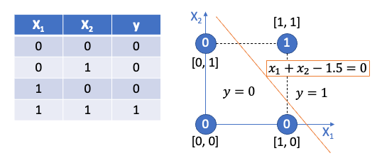
Decision Boundary
The perceptron learns a decision boundary: w₁x₁ + w₂x₂ + b = 0
Points above the line are classified as 1
Points below the line are classified as 0
For AND gate, only the point (1,1) should be above the line

Slide 17
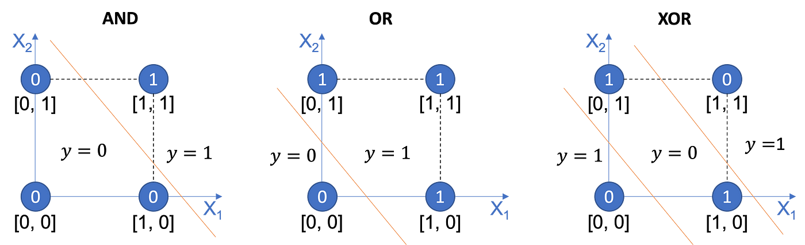
Limitations of Simple Perceptron
Can only learn linearly separable patterns
Cannot solve XOR problem (need multiple layers)
No probabilistic output
Simple update rule isn't suitable for complex problems

Slide 18
Introduction to Neural Networks
Multi-Layer Neural Network

Slide 19
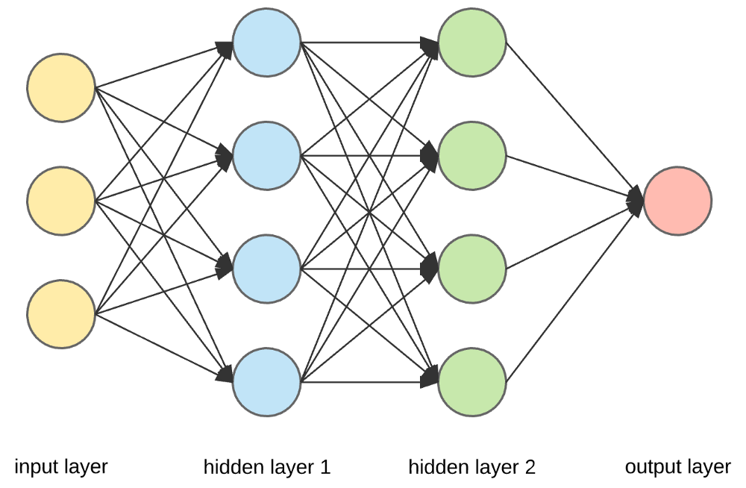
What is a Neural Network?
A neural network is a computational model inspired by the human brain.
It consists of layers of interconnected nodes (neurons) that process data.
Used for pattern recognition, decision-making, and AI applications.

Slide 20
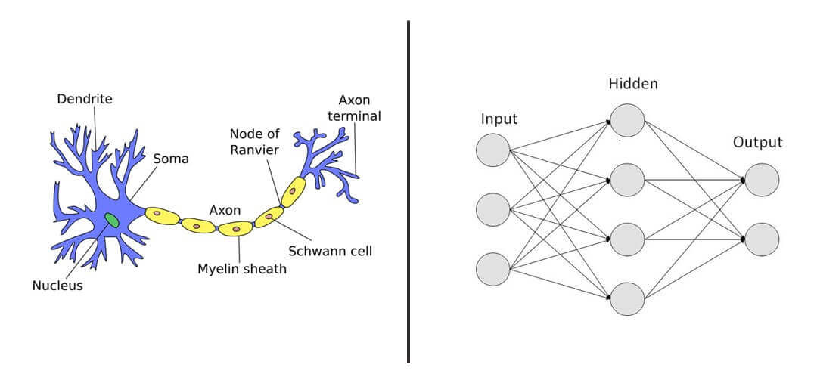
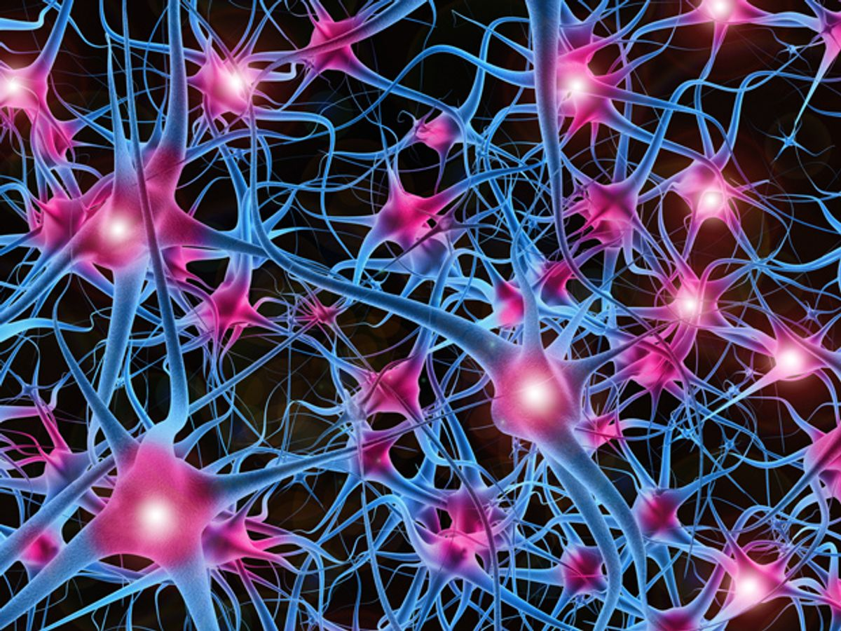
Inspiration from the Human Brain
Neural networks are modeled after biological neurons in the brain.
Neurons receive inputs, process them, and pass the output to other neurons.
Just like the brain, networks learn from experience (training).

Slide 21
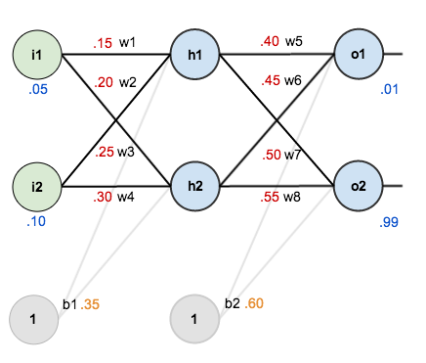
Structure of a Neural Network
Three main layers:
Input Layer – Receives raw data.
Hidden Layers – Process information using mathematical operations.
Output Layer – Produces the final result.
Each connection has a weight, which determines importance.

Slide 22
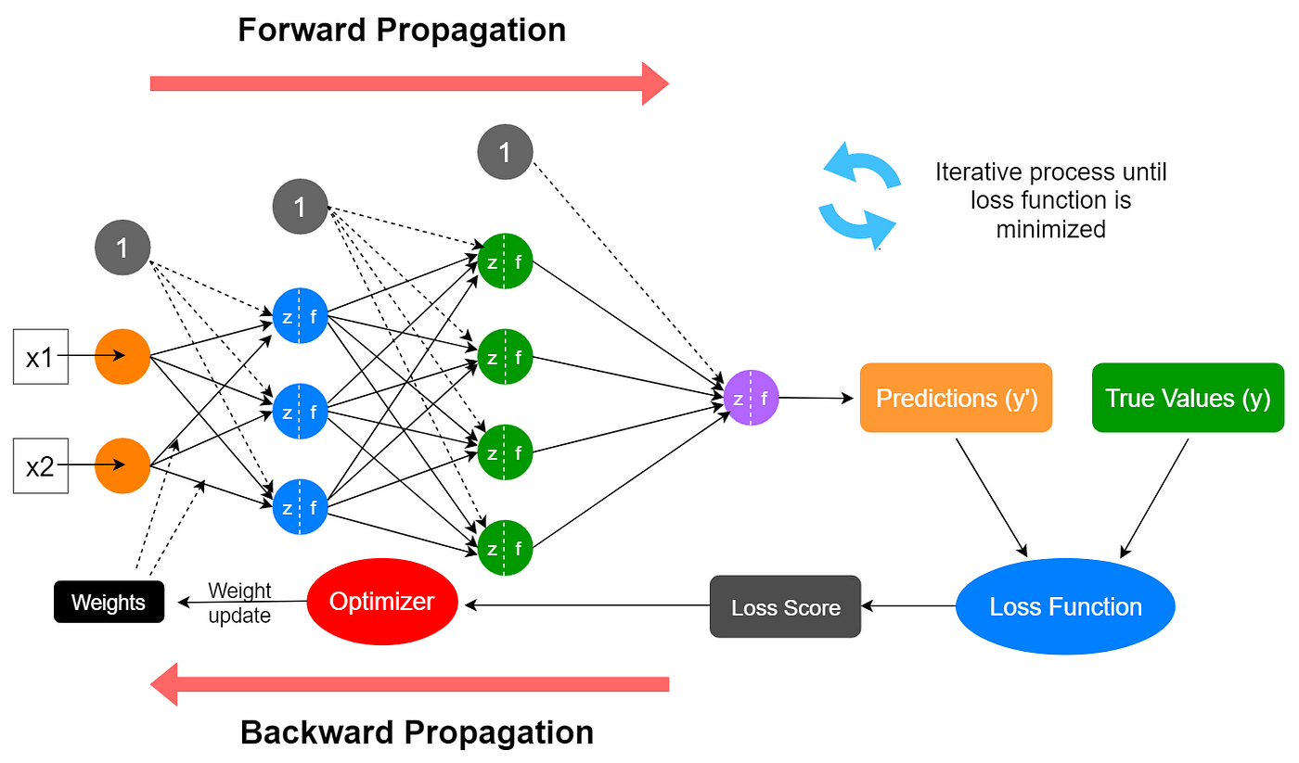
How Neural Networks Learn
Training Process:
Feed data into the network.
Compute the output using weights.
Compare the output with the correct answer (loss calculation).
Adjust weights using backpropagation & gradient descent to improve accuracy.

Slide 23
Types of Neural Networks
Feedforward Neural Network (FNN) – Basic type; flows in one direction.
Convolutional Neural Network (CNN) – Used for image recognition.
Recurrent Neural Network (RNN) – Processes sequential data like speech.
Transformer Models – Advanced networks for NLP (e.g., GPT, BERT).
https://towardsai.net/p/deep-learning/main-types-of-neural-networks-and-its-applications-tutorial-734480d7ec8e

Slide 24
Applications of Neural Networks
Image Recognition (e.g., Face Detection, Object Recognition)
Natural Language Processing (e.g., Chatbots, Translation)
Speech Recognition (e.g., Siri, Google Assistant)
Medical Diagnosis (e.g., Detecting diseases from X-rays)

Slide 25
Challenges & Limitations
High computational cost – Needs powerful hardware (GPUs, TPUs).
Large datasets required – More data = better accuracy.
Black-box nature – Difficult to interpret decisions.
Overfitting – Model may memorize instead of generalizing.

Slide 26
Future of Neural Networks
More efficient architectures (e.g., Transformer models).
Quantum AI – Using quantum computing for better performance.
Smaller & faster models for edge devices (e.g., mobile AI).
Ethical AI – Addressing bias, fairness, and transparency.

Slide 27
How Does Neural Networks Work?

Slide 28
Neural Networks Intuition
Suppose we have this data, and we want to build a model that establishes the relationship between x and y e.g. y = a * x
One can clearly make out that y = 4 * x.
But how can a neural network derive the relationship between y and x?
x | y
0 | 0
1 | 4
2 | 8
3 | 12
4 | 16

Slide 29
How can a neural network find the value of a?
Step1: Random Guess
We need to start somewhere, we can randomly guess the desired multiplier is 2.
The relationship will now look like y = 2 * x
Step 2: Forward Propagation
Here we are propagating the calculation forward from the input —> output.
So now the table would look like this:
X | Predicted Y’
0 | 2 * x = 0
1 | 2 * x = 2
2 | 2 * x = 4
3 | 2 * x = 6
4 | 2 * x = 8

Slide 30
Calculate the Error
Step 3: Error
Let us compare the prediction versus the actual.
We calculate the error as the square of deviation of the actual from the predicted y’. This way we penalize the error irrespective of the direction of error.
x | Actual y | Predicted y’ | Squared error(y-y’)²
0 | 0 | 0 | 0
1 | 4 | 2 | 4
2 | 8 | 4 | 16
3 | 12 | 6 | 36
4 | 16 | 8 | 64
TOTAL |  |  | 120

Slide 31
Minimize Error
Step 4: Minimize Error
The next logical step is to minimize the error, we randomly initialized 2 as the multiplier.
Based on that, the error was 120, we can try to deal with many other values ranging from -100 to 100.
Since we know the real value (4), we will end up with the correct value quickly.
But, in practice, when you deal with a lot more variables (here there is only one: x) and with more complex relationships, trying out different random values for x is not scalable, and not an efficient use of computing resources.

Slide 32
The Derivates Method إيجاد الحل باستخدام الاشتقاق أو معدل تغير الاقتران عند قيمة (x) معينة
A popular way to solve this problem is with the help of differentiation or derivatives.
Basically, derivatives are the rate of change of a function with respect to one of its variables.
In our example, it is the rate of change in the error or loss function with respect to x.
To observe the effect of change, let’s change the multiplier or weight or the parameter from 2 to 2.0001 i.e. increase it by 0.0001 and then decrease it by the same amount.
In practice, this increase is even smaller, let us observe the impact:
x | Actual y | Weight = 2 | Squared Error @ 2 | Weight = 2.0001 | Squared Error @ 2.0001 | Weight = 1.9999 | Squared Error @ 1.9999
0 | 0 | 0 | 0 | 0 | 0 | 0 | 0
1 | 4 | 2 | 2 | 2.0001 | 3.99 | 1.9999 | 4.0004
2 | 8 | 4 | 16 | 4.0002 | 15.99 | 3.9998 | 16.0016
3 | 12 | 6 | 36 | 6.0003 | 35.99 | 5.9997 | 36.0036
4 | 16 | 8 | 64 | 8.0004 | 63.99 | 7.9996 | 64.006
4 | 16 | 8 | 64 | 8.0004 | 63.99 | 7.9996 | 64.006
TOTAL |  |  | 120 |  | 119.988 |  | 120.012

Slide 33
The Derivates Method
With the increase in weight by 0.0001, the loss (the total error) decreased by 0.012. Also, when we decreased the weight by 0.0001, the loss increased by 0.012.
For a 0.0001 increase in weight, the loss decreased by 120 times (0.012 / 0.0001).
So how much should we increase our weight to reduce the loss?
If we take a different arbitrary number such as 7 for the weight value, the loss increases to 270. So, we know now that the weight should be somewhere between 2 and 7.
Findings:
If we decrease the weight from 2, the loss increases.
If we increase the weight from 2, the loss decreases up to a point and then it increases as loss is high at weight = 7

Slide 34
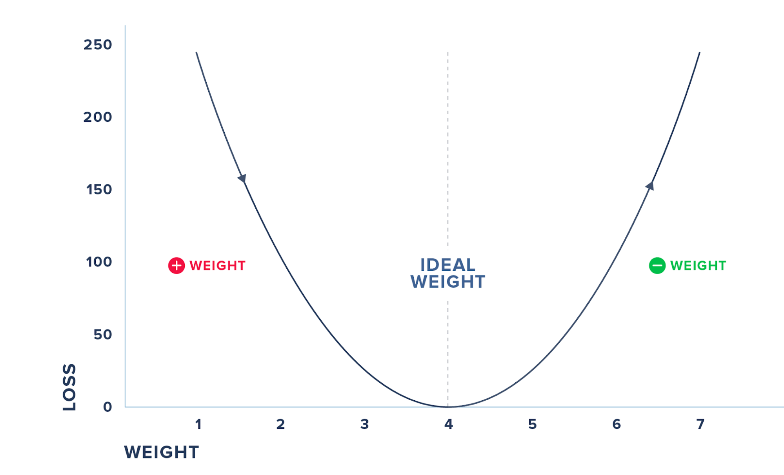
The Derivates Method
We cannot do this iterative process of randomly checking for various weights and arriving at the magical parameter.
Moreover, in practice, you will have to deal with many input variables and not just one.
Hence, we can use derivatives where we check the effect on loss for a small change in the input.
The figure summarizes the steps where we check for the derivative and increase the weights, if the loss decreases and vice-versa before we hit the weight where the loss reaches 0.
We do this iteratively and update the weights and the loss till we minimize the loss to 0.
The process by which we calculate the derivatives needed in the calculation of weights is called back propagation.

Slide 35
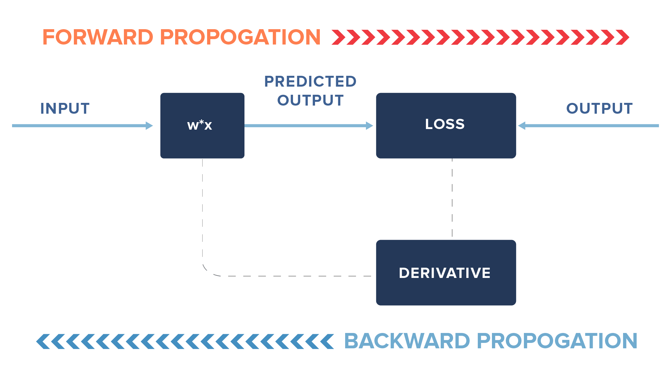
The Derivates Method
In practice, we may not update our weights fully but only by a fraction of the new learned change in weights (i.e. instead of 0.0001, we may update it by a fraction of 0.0001).
Additionally, we may stop earlier than the loss reaches 0, say for example, we may stop if the loss reaches 0.000001.

Slide 36
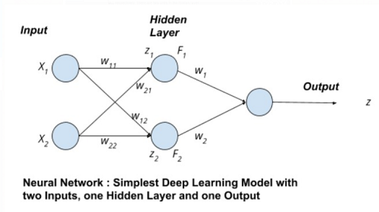
The Derivates Method
In general, neural networks have more than one input variable and also they have hidden layers, but the general concept of computation is similar to what we have discussed.
In the diagram shown on the right, we have 4 inputs or nodes in the input layer, 2 nodes in the hidden layer, and 1 node in the output layer.
The lines indicate the connection each node has with the node in the layer following it.
The connections are through the weights involved, which are learned via forward and back propagation.
z1 = x1 * w11 + x2 * w21
z2 = x1 * w12 + x2 * w22
Here, “w” refers to weights connecting input layer to hidden layer. Likewise, we have a set of weights from hidden layer to output layer. The earlier case had just one of the input nodes and one output node with the connection.
In case we are tasked with classifying items such as digits from 0 to 9 (multi-class output), we will have 10 nodes (each digit represented by one node) in the output layer instead of one. Likewise, we can have multiple hidden layers too.

Slide 37
Code Examples

Slide 38
Example 1: A Simple "Neuron" in Python
import numpy as np
# Inputs (features)
inputs = np.array([1.0, 2.0, 3.0]) # Example input data
# Weights (coefficients)
weights = np.array([0.5, -0.2, 0.3]) # Randomly chosen weights
# Bias (extra term)
bias = 0.7
# Compute output (weighted sum + bias)
output = np.dot(inputs, weights) + bias
print("Output of the neuron:", output)
This code demonstrates the computation implemented by a single neuron.
The neuron computes the expression: 1.0*0.5 + 2.0*(-0.2) + 3.0*0.3 + 0.7
It uses the dot product command to perform matrix multiplication.

Slide 39
Example 2: The Perceptron Similar to the previous example only with a step function
import numpy as np
# Step activation function (Binary output: 0 or 1)
def step_function(x):
return 1 if x > 0 else 0
# Inputs and weights
inputs = np.array([1.0, 2.0, 3.0])
weights = np.array([0.5, -0.2, 0.3])
bias = 0.7
# Compute output
output = np.dot(inputs, weights) + bias
perceptron_output = step_function(output)
print("Perceptron output:", perceptron_output)
A perceptron typically includes a step activation function (e.g., y = 1 if output > 0 else 0).
Without activation, it’s just a linear function (weighted sum).
The step_function ensures binary classification (0 or 1).
If output is positive, perceptron fires (1); otherwise, it doesn’t (0).

Slide 40
A Simple Neural Network (No Libraries)
import numpy as np
# Sigmoid activation function
def sigmoid(x):
return 1 / (1 + np.exp(-x))
# Inputs
inputs = np.array([0.5, 0.3]) # Two inputs
# Weights for hidden layer (2 inputs → 2 neurons)
weights_hidden = np.array([[0.4, 0.7], [-0.2, 0.5]])
# Bias for hidden layer
bias_hidden = np.array([0.1, 0.2])
# Compute hidden layer output
hidden_layer_input = np.dot(inputs, weights_hidden) + bias_hidden
hidden_layer_output = sigmoid(hidden_layer_input)
print("Hidden layer output:", hidden_layer_output)
Explanation:
Uses sigmoid activation to keep values between 0 and 1.
Basic feedforward step for two neuron

Slide 41
Building a Neural Network using TensorFlow/Keras
import tensorflow as tf
from tensorflow import keras
import numpy as np
# Generate dummy data (X: features, y: labels)
X = np.array([[0, 0], [0, 1], [1, 0], [1, 1]]) # Inputs (XOR gate)
y = np.array([[0], [1], [1], [0]]) # Expected output (XOR results)
# Create a simple neural network
model = keras.Sequential([
keras.layers.Dense(4, activation='relu'), # Hidden layer (4 neurons)
keras.layers.Dense(1, activation='sigmoid') # Output layer (1 neuron)
])
# Compile the model
model.compile(optimizer='adam', loss='binary_crossentropy', metrics=['accuracy'])
# Train the model
model.fit(X, y, epochs=100, verbose=0) # Train for 100 epochs silently
# Make a prediction
prediction = model.predict(X)
print("Predictions:", prediction)
Explanation:
Uses Keras to create a simple XOR classifier.
ReLU for hidden layer, sigmoid for binary classification.
Trains for 100 epochs to find best weights.

Slide 42
Introduction to Word Embeddings

Slide 43
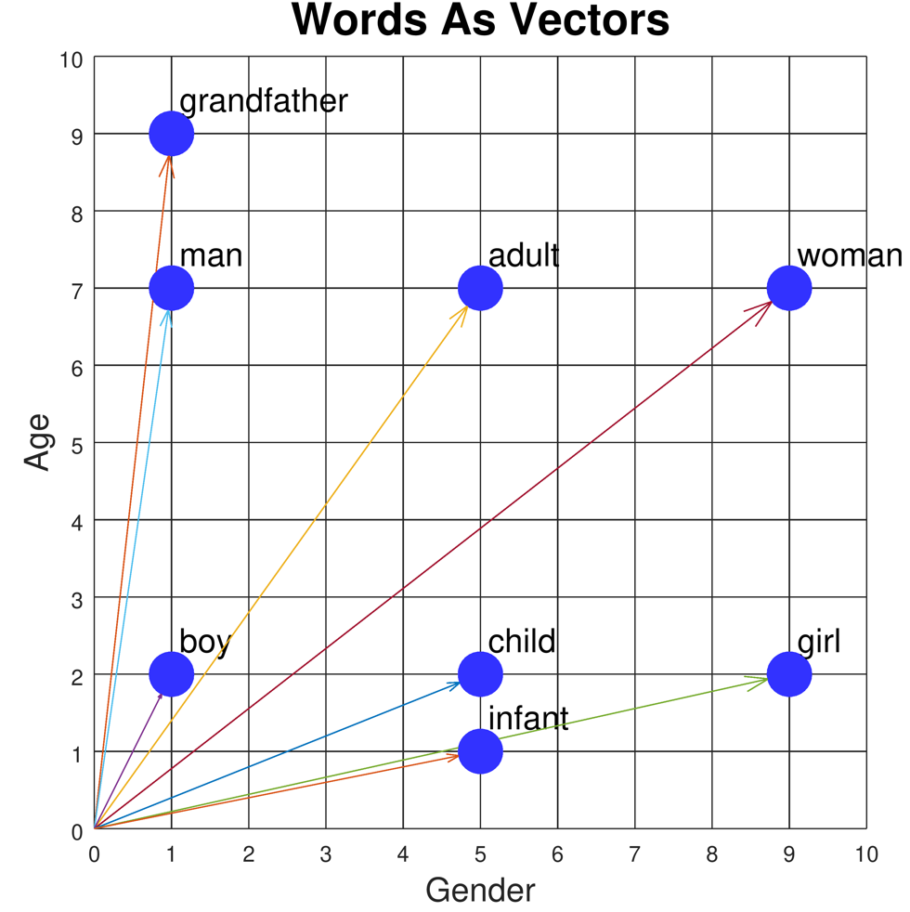
Introduction to Word Embeddings
Definition: Word embeddings are vector representations of words in a continuous vector space.
Purpose: Capture semantic and syntactic relationships between words.
Key innovation: Words with similar meanings have similar vector representations.
Foundation of modern NLP: Enable machines to understand relationships between words.

Slide 44
The Evolution of Word Representations
Traditional Methods (Pre-2013)
One-hot encoding: Sparse, binary vectors (dimension = vocabulary size)
Limitations:
No notion of similarity between words
Curse of dimensionality
No semantic information captured
Word | Dimension 1 (cat) | Dimension 2 (dog) | Dimension 3 (fish) | Dimension 4 (bird)
cat | 1 | 0 | 0 | 0
dog | 0 | 1 | 0 | 0
fish | 0 | 0 | 1 | 0
bird | 0 | 0 | 0 | 1

Slide 45
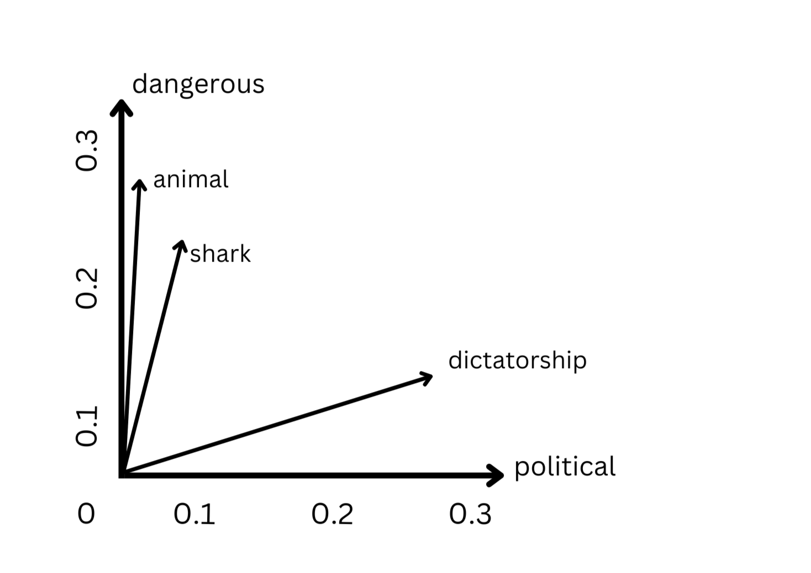
The Evolution of Word Representations
Problem: How do we represent meaning mathematically?
Solution: Distributional hypothesis - "You shall know a word by the company it keeps" (J.R. Firth, 1957)
Word | Dimension 1 (political) | Dimension 2 (dangerous)
shark | 0.05 | 0.22
animal | 0.03 | 0.25
dangerous | 0.07 | 0.32
political | 0.31 | 0.04
dictatorship | 0.28 | 0.15
Words are represented as dense vectors in a continuous vector space
Each dimension potentially captures semantic meaning
Similar words cluster together in the vector space
Semantic relationships are preserved (e.g., "shark" is closer to "dangerous" than "political")
Enables meaningful similarity measurements and analogies

Slide 46
Word Similarities
import numpy as np
from sklearn.metrics.pairwise import cosine_similarity
# Fake word vectors (3D for simplicity)
word_vectors = {
"king": np.array([0.8, 0.65, 0.1]),
"queen": np.array([0.78, 0.66, 0.12]),
"man": np.array([0.9, 0.1, 0.1]),
"woman": np.array([0.88, 0.12, 0.12]),
"apple": np.array([0.1, 0.8, 0.9]),
}
def similarity(w1, w2):
return cosine_similarity([word_vectors[w1]], [word_vectors[w2]])[0][0]
print("Similarity(king, queen):", similarity("king", "queen"))
print("Similarity(man, woman):", similarity("man", "woman"))
print("Similarity(king, apple):", similarity("king", "apple"))

Slide 47
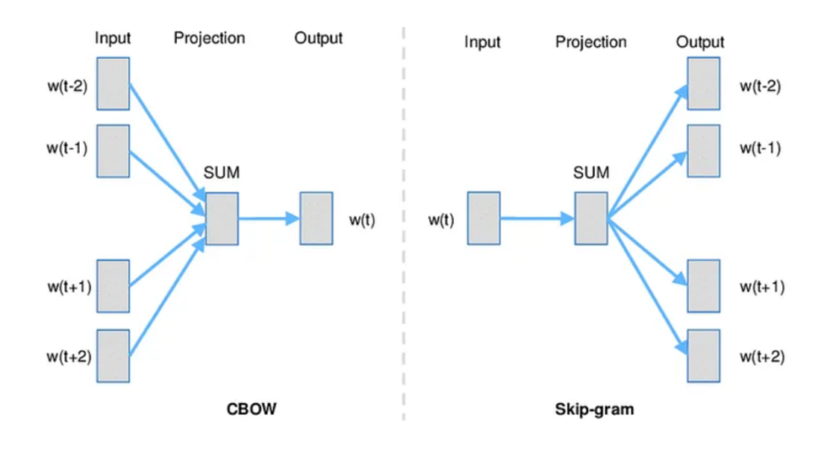
Word2Vec (Mikolov et al., 2013)
Key Innovation
Transformed NLP by creating dense vector representations through prediction-based models
Two Architectures
Continuous Bag of Words (CBOW):
Predicts target word from context words
Faster training, better for frequent words
Skip-gram:
Predicts context words from target word
Better for rare words, captures more semantic information
Characteristics
Typically 100-300 dimensions (vs. vocabulary size)
Linear relationships: king - man + woman ≈ queen
Efficient training through negative sampling
Limitations: Fixed vectors, one vector per word regardless of context

Slide 48
Real Embeddings
pip install spacy
python -m spacy download en_core_web_md
import spacy
nlp = spacy.load("en_core_web_md")
word1 = nlp("king")
word2 = nlp("queen")
print("Similarity:", word1.similarity(word2))

Slide 49
import gensim
from gensim.models import Word2Vec
import nltk
from nltk.tokenize import word_tokenize
nltk.download('punkt')
# Sample corpus
sentences = [
"Large language models are transforming business applications",
"Natural language processing helps computers understand human language",
"Word embeddings capture semantic relationships between words",
"Neural networks learn distributed representations of words",
"Businesses use language models for various applications",
"Customer service can be improved with language technology",
"Modern language models require significant computing resources",
"Language models can generate human-like text for businesses"]
# Tokenize the sentences
tokenized_sentences = [word_tokenize(sentence.lower()) for sentence in sentences]
# Train Word2Vec model
model = Word2Vec(sentences=tokenized_sentences,
vector_size=100, # Embedding dimension
window=5, # Context window size
min_count=1, # Minimum word frequency
workers=4) # Number of threads
# Save the model
model.save("word2vec.model")
# Find the most similar words to "language"
similar_words = model.wv.most_similar("language", topn=5)
print("Words most similar to 'language':")
for word, similarity in similar_words:
print(f"{word}: {similarity:.4f}")
# Vector for a specific word
word_vector = model.wv["business"]
print(f"\nVector for 'business' (first 10 dimensions):\n{word_vector[:10]}")
# Word analogies
analogy_result = model.wv.most_similar(positive=["business", "language"],
negative=["models"],
topn=3)
print("\nAnalogy results:")
for word, similarity in analogy_result:
print(f"{word}: {similarity:.4f}")

Slide 50
Practical Implementation: Word2Vec in Python
import gensim.downloader as api
from gensim.models import Word2Vec
import numpy as np
# Load pre-trained Word2Vec model
word2vec_model = api.load('word2vec-google-news-300’)
# Find similar words
similar_words = word2vec_model.most_similar('computer', topn=5)
print("Words similar to 'computer':", similar_words)
# Word analogies
result = word2vec_model.most_similar(positive=['woman', 'king'], negative=['man'], topn=1)
print("king - man + woman =", result)
# Train your own Word2Vec model
sentences = [["cat", "say", "meow"], ["dog", "say", "woof"]]
model = Word2Vec(sentences, vector_size=100, window=5, min_count=1, workers=4)
# Get vector for a word
cat_vector = model.wv['cat']
print("Vector for 'cat':", cat_vector[:5]) # Show first 5 dimensions

Slide 51
Practical Implementation: GloVe in Python
import numpy as np
from sklearn.metrics.pairwise import cosine_similarity
# Function to load GloVe vectors
def load_glove_vectors(file_path):
embeddings_dict = {}
with open(file_path, 'r', encoding='utf-8') as f:
for line in f:
values = line.split()
word = values[0]
vector = np.array(values[1:], dtype='float32')
embeddings_dict[word] = vector
return embeddings_dict
# Load pre-trained GloVe vectors
glove_vectors = load_glove_vectors('glove.6B.100d.txt')
# Calculate word similarity
def get_similarity(word1, word2, embeddings):
if word1 in embeddings and word2 in embeddings:
vec1 = embeddings[word1].reshape(1, -1)
vec2 = embeddings[word2].reshape(1, -1)
return cosine_similarity(vec1, vec2)[0][0]
return None
# Example usage
similarity = get_similarity('king', 'queen', glove_vectors)
print(f"Similarity between 'king' and 'queen': {similarity:.4f}")

Slide 52
Practical Implementation: BERT in Python
import torch
from transformers import BertModel, BertTokenizer
# Load pre-trained BERT model and tokenizer
tokenizer = BertTokenizer.from_pretrained('bert-base-uncased')
model = BertModel.from_pretrained('bert-base-uncased')
# Input text
text = "The quick brown fox jumps over the lazy dog."
# Tokenize input
inputs = tokenizer(text, return_tensors="pt")
# Get BERT embeddings
with torch.no_grad():
outputs = model(**inputs)
# Last hidden states contain contextual embeddings for each token
last_hidden_states = outputs.last_hidden_state
# Get embedding for the first token (after [CLS])
word_embedding = last_hidden_states[0, 1].numpy()
print(f"BERT embedding for 'The' (first 5 dimensions): {word_embedding[:5]}")
# Get embeddings for full sentence (CLS token)
sentence_embedding = last_hidden_states[0, 0].numpy()

Slide 53
What is a Large Language Model?
A Large Language Model (LLM) is an advanced artificial intelligence system trained on vast amounts of text data to understand, generate, and manipulate human language. These models use deep learning, particularly transformers, to predict and generate text in a coherent and context-aware manner.
Key features:
Trained on billions of words from books, articles, and the internet.
Can perform tasks like translation, summarization, code generation, and answering questions.
Examples include GPT-4, ChatGPT, BERT, PaLM, LLaMA, and Claude.
LLMs power modern AI applications, including chatbots, virtual assistants, and content creation tools.

Slide 54
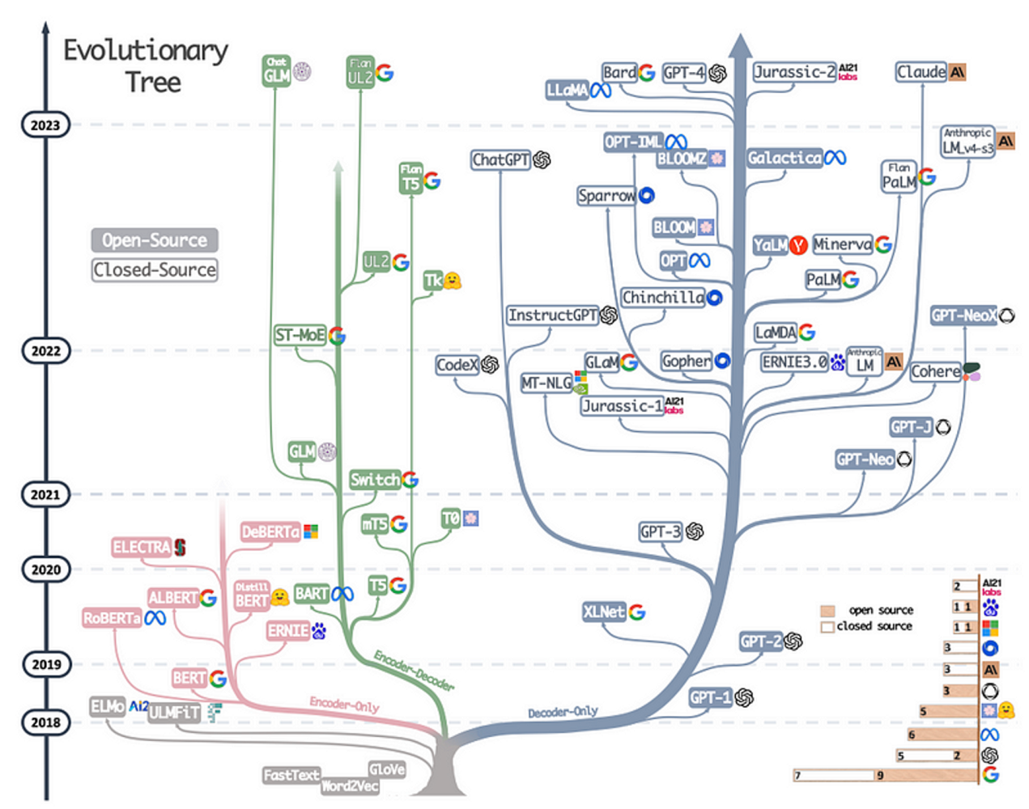
Evolution of Large Language Models
The image is an evolutionary tree of natural language processing (NLP) models, showing their development from 2018 to 2023. It categorizes models into open-source (light color) and closed-source (darker color), tracking major advancements in transformer-based architectures.
Key highlights:
Early models (2018-2019): Word embeddings like Word2Vec, FastText, GloVe, evolving into transformer-based models like BERT, RoBERTa, and XLNet.
Growth in 2020-2021: Expansion into encoder-only (e.g., ELECTRA, ALBERT), encoder-decoder (e.g., T5, BART), and decoder-only models (GPT-2, GPT-3).
2022-2023 advancements: Introduction of ChatGPT, GPT-4, Claude, PaLM, LLaMA, Bard, BLOOM, and more, reflecting both research-driven (open-source) and commercial (closed-source) efforts.
The diagram illustrates the competition and innovation between Google, OpenAI, Meta, AI21 Labs, and Anthropic, among others.

Slide 55
Introduction to HuggingFace

Slide 56
Introduction to LLM Agents

Slide 57
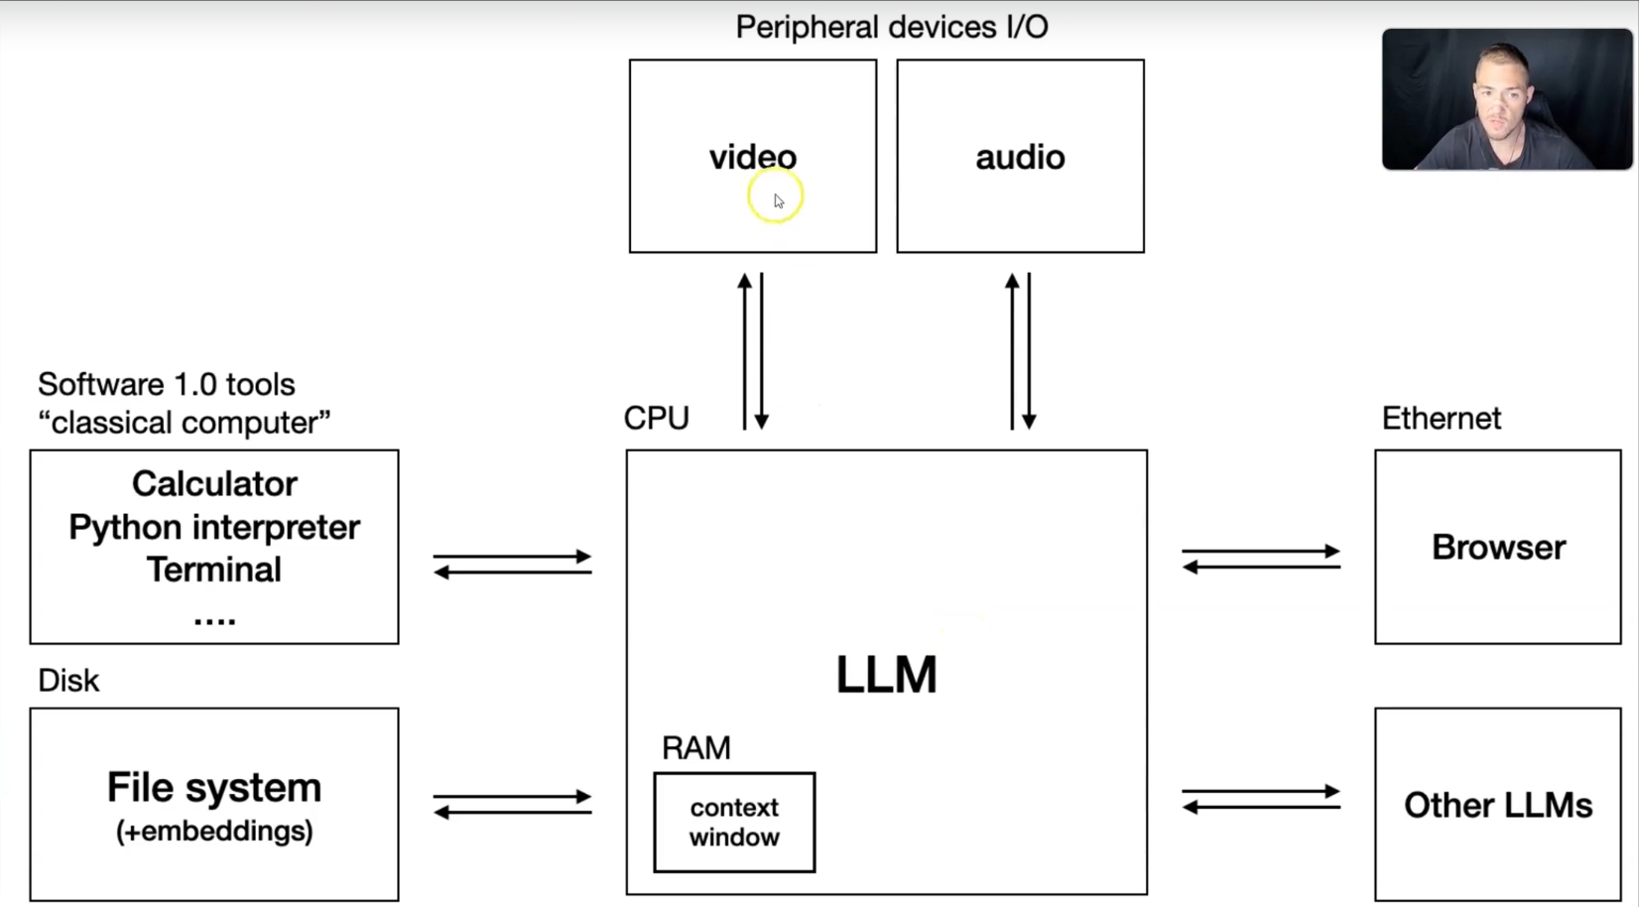
LLM Agents

Slide 58
Core LLM Concepts

Slide 59
Encoder vs. Decoder Architectures
Encoder Architecture
Bidirectional context processing (sees full context)
Focused on representation learning
Ideal for understanding tasks: classification, NER, sentiment analysis
Examples: BERT, RoBERTa, DeBERTa
Output: contextual embeddings for each token
Decoder Architecture
Unidirectional/autoregressive processing (sees only past context)
Focused on text generation
Ideal for generative tasks: text completion, summarization, translation
Examples: GPT models, LLaMA, Claude
Output: probability distribution for next token
Encoder-Decoder Architecture
Combines both approaches
Encoder processes input, decoder generates output
Ideal for sequence-to-sequence tasks: translation, summarization
Examples: T5, BART, PaLM-E
Output: generated sequence based on encoded input

Slide 60
Self-Attention Mechanisms
Key Innovation in Transformers
Computes relationships between all tokens in a sequence
Allows modeling of long-range dependencies
Parallel computation (unlike sequential RNNs)
Self-Attention Computation
For each token, create query (Q), key (K), and value (V) vectors
Compute attention scores: how much each token should attend to others
Apply softmax to get attention weights
Create weighted sum of value vectors
Formula: Attention(Q, K, V) = softmax(QK^T/√d_k)V
Multi-Head Attention
Run multiple attention mechanisms in parallel
Each "head" can focus on different aspects of relationships
Outputs concatenated and projected to original dimension
Enables the model to jointly attend to information from different representation subspaces

Slide 61
Positional Encoding
The Position Problem
Self-attention is permutation-invariant (order insensitive)
Language inherently depends on word order
Need to inject position information
Sinusoidal Positional Encoding (Vaswani et al.)
Fixed encoding using sine and cosine functions
Different frequencies for different dimensions
Formula:
PE(pos, 2i) = sin(pos/10000^(2i/d_model))
PE(pos, 2i+1) = cos(pos/10000^(2i/d_model))
Allows model to extrapolate to sequence lengths not seen during training
Learned Positional Encoding
Position embeddings learned during training
Can capture more nuanced position relationships
Limited to maximum sequence length seen during training
Used in models like BERT, RoBERTa
Relative Positional Encoding
Encode relative distances between tokens rather than absolute positions
Improves handling of longer sequences
Examples: T5, DeBERTa

Slide 62
Tokenization Strategies
Purpose of Tokenization
Convert raw text into discrete tokens for model processing
Manage vocabulary size and out-of-vocabulary words
Balance between granularity and context window efficiency
Word-Level Tokenization
Each token is a complete word
Pros: Semantically meaningful units
Cons: Large vocabulary, many OOV words
Example: early Word2Vec implementations
Character-Level Tokenization
Each token is a single character
Pros: Tiny vocabulary, no OOV issues
Cons: Loses word-level semantics, requires longer sequences
Example: Character-level CNN/RNN models
Subword Tokenization
Balance between word and character levels
Common algorithms:
Byte-Pair Encoding (BPE): Iteratively merge most frequent character pairs
WordPiece: Similar to BPE but uses likelihood rather than frequency
Unigram Language Model: Probabilistic approach
SentencePiece: Language-agnostic, treats whitespace as a character
Examples: GPT models use BPE variants, BERT uses WordPiece

Slide 63
Transfer Learning and Fine-tuning
Transfer Learning Paradigm
Pre-train model on large general corpus
Adapt to downstream tasks with less data
Leverages general language knowledge for specific applications
Pre-training Approaches
Self-supervised learning on unlabeled text
Masked Language Modeling (MLM) for encoders
Causal Language Modeling (CLM) for decoders
Seq2Seq objectives for encoder-decoder models
Fine-tuning Methods
Full Fine-tuning: Update all model parameters
Most flexible but computationally expensive
Prone to catastrophic forgetting
Parameter-Efficient Fine-tuning (PEFT):
LoRA (Low-Rank Adaptation): Add trainable low-rank matrices
Adapter Layers: Insert small trainable modules
Prompt Tuning: Optimize continuous prompt embeddings
Prefix Tuning: Prepend trainable vectors to key and value
Benefits of PEFT:
Reduces computational requirements
Minimizes storage needs
Prevents catastrophic forgetting
Enables multi-task learning

Slide 64
Additional Key Concepts
Attention Mask
Controls which tokens can attend to which others
Essential for implementing causal attention in decoders
Handles variable sequence lengths and special tokens
Layer Normalization
Normalizes activations across features
Stabilizes and accelerates training
Applied before or after attention and feed-forward blocks
Residual Connections
Allow direct flow of information through layers
Help mitigate vanishing gradient problem
Enable training of very deep networks
Feed-Forward Networks
Two-layer neural networks with ReLU/GELU activation
Applied to each position separately and identically
Often where most parameters in the model reside
Formula: FFN(x) = max(0, xW₁ + b₁)W₂ + b₂
Activation Functions
GELU (Gaussian Error Linear Unit): Smoother than ReLU
SwiGLU: Enhanced variant used in PaLM and newer models
Used in feed-forward networks between layers

Slide 65
Model Architecture Components
Embedding Layer
Converts token IDs to dense vectors
Typically 768-4096 dimensions in modern LLMs
Often tied with output layer weights
Transformer Blocks/Layers
Basic building unit of transformer models
Each block contains:
Self-attention mechanism
Feed-forward network
Layer normalization
Residual connections
Modern LLMs contain dozens to hundreds of layers
Output Layer
Projects final hidden states to vocabulary size
For decoders: produces next-token probabilities
For encoders: produces task-specific outputs after fine-tuning
Scaling Patterns
Deeper models (more layers)
Wider models (larger hidden dimensions)
More attention heads
Trade-offs between depth, width, and compute efficiency

Slide 66
Training Methodologies

Slide 67
Pre-training Objectives
Masked Language Modeling (MLM)
Used in encoder models like BERT
Random tokens are masked (typically 15%)
Model predicts the original tokens
Variants:
Whole Word Masking: Mask all subwords of a word
SpanBERT: Mask contiguous spans instead of random tokens
RoBERTa: Dynamic masking (new masks each epoch)
Causal Language Modeling (CLM)
Used in decoder models like GPT
Predict next token given previous tokens
Maximizes likelihood: P(xₙ|x₁,...,xₙ₋₁)
Training employs teacher forcing (use ground truth as context)
Loss function: cross-entropy over vocabulary
Denoising Objectives
Text Infilling: Fill in arbitrary spans of text (T5, BART)
Sentence Permutation: Recover original order of shuffled sentences
Document Rotation: Identify start of document
Benefits: More challenging tasks lead to better representations
Contrastive Learning
Learn similarities between related text pairs
Maximize agreement between positive pairs, minimize for negatives
Examples: SimCSE, CLIP (for multimodal learning)

Slide 68
Scaling Laws
Parameter Scaling (Kaplan et al., 2020)
Performance improves as power-law with model size
Loss ∝ N⁻ᵃ where N is parameter count and a ≈ 0.076
Larger models learn more efficiently per data token
Diminishing returns but no observed plateau
Data Scaling
Performance improves with training data
Loss ∝ D⁻ᵇ where D is dataset size and b ≈ 0.095
High-quality, diverse data more important than quantity
Data exhaustion becomes limiting factor at extreme scales
Compute Scaling
Performance improvements predictable with compute
Optimal allocation balances model size vs. training tokens
Compute-optimal training: train larger models on fewer steps
Chinchilla Scaling (Hoffmann et al., 2022)
Revised optimal scaling rules
For compute-optimal training:
Model size (N) and dataset size (D) should scale equally
20 tokens per parameter is optimal
Smaller, more thoroughly trained models outperform larger, undertrained ones

Slide 69
Alignment Techniques
Supervised Fine-Tuning (SFT)
Train on curated, high-quality examples of desired behavior
Examples created by human demonstrators
First step in alignment process
Relatively straightforward to implement
Reinforcement Learning from Human Feedback (RLHF)
Three-stage process:
SFT: Initial fine-tuning on demonstration data
Reward Modeling: Train model to predict human preferences
RL Optimization: Optimize policy using reward model
Algorithms:
Proximal Policy Optimization (PPO)
Rejection Sampling Fine-Tuning
Reinforcement Learning with AI Feedback (RLAIF)
Replace human feedback with AI evaluator models
Advantages:
Scalability: generate more feedback
Consistency: less variation in judgments
Cost efficiency
Still requires human oversight and calibration
Constitutional AI (CAI)
Model critiques its own outputs
Uses predefined set of principles ("constitution")
Process:
Generate initial responses
Self-critique based on constitutional principles
Revise responses based on critique
Train on preferred revisions
Reduces reliance on direct human feedback

Slide 70
Emergent Abilities with Scale
Emergence Definition
Capabilities not present in smaller models
Qualitative jumps rather than smooth improvements
Often unpredicted by extrapolation from smaller scales
Key Emergent Abilities
In-context learning: Few-shot and zero-shot learning
Instruction following without explicit training
Chain-of-thought reasoning
Code generation and understanding
Multimodal reasoning
Tool use and planning
Scaling Thresholds
Different abilities emerge at different scales
Basic instruction following: ~10B parameters
Complex reasoning: ~100B parameters
Sophisticated tool use: 100B+ parameters
Theoretical Perspectives
Phase transitions in learning dynamics
Compression breakthrough theory
Grokking phenomenon: sudden generalization after extended training

Slide 71
Training Infrastructure
Distributed Training
Data Parallelism: Same model, different data shards
Model Parallelism: Different model parts, same data
Pipeline Parallelism: Stage model across devices
Tensor Parallelism: Split individual tensors across devices
ZeRO (Zero Redundancy Optimizer): Optimize memory usage
Hardware Considerations
GPU clusters with high-bandwidth interconnects
TPU pods for specialized training
Memory optimization techniques:
Gradient checkpointing
Mixed precision training
Activation recomputation
Optimizer state partitioning
Training Optimizations
Optimizer selection: Adam, AdamW, Adafactor
Learning rate scheduling: Warmup, decay, cosine
Gradient accumulation
Flash Attention: Efficient attention computation
Activation functions: GELU, SwiGLU

Slide 72
Advanced Training Approaches
Mixture of Experts (MoE)
Sparse activation: only a subset of parameters active per token
Router network determines which expert handles each token
Benefits:
Increases parameter count without proportional compute
Specialization of different experts
Challenges:
Load balancing across experts
Router optimization
Examples: Switch Transformers, GLaM, Mixtral
Continual Pre-training
Update models with new data over time
Maintain performance on old tasks while learning new information
Addresses temporal drift in knowledge
Techniques to prevent catastrophic forgetting:
Experience replay
Elastic weight consolidation
Knowledge distillation from previous versions
Multitask Training
Train on multiple objectives simultaneously
Improves generalization and transfer learning
Examples:
T5: Multi-task language understanding
Flan: Instruction tuning across thousands of tasks
PaLM: Interleaved training on diverse data sources
Multimodal Training
Incorporate non-text modalities: images, audio, video
Alignment between modalities using contrastive objectives
Examples: CLIP, Flamingo, GPT-4V
Challenges: Cross-modal attention, modality gaps

Slide 73
Evaluation Frameworks

Slide 74
Benchmark Datasets
General Language Understanding
GLUE (General Language Understanding Evaluation)
Collection of 9 sentence/paragraph-level tasks
Tasks: sentiment analysis, paraphrase detection, NLI
Simple single-sentence or sentence-pair tasks
SuperGLUE
More challenging successor to GLUE
Includes more complex reasoning tasks
Example tasks: WiC (word sense disambiguation), ReCoRD (reading comprehension)
Knowledge and Reasoning
MMLU (Massive Multitask Language Understanding)
57 subjects across STEM, humanities, social sciences
Multiple-choice format tests world knowledge
Designed to assess breadth of knowledge
BIG-Bench
204 diverse tasks beyond traditional NLP
Evaluates capabilities like logical reasoning, common sense
Community-contributed tasks with varying difficulty
Specialized Benchmarks
TruthfulQA: Tests factuality and honesty
HumanEval/MBPP: Code generation and understanding
HellaSwag: Common sense reasoning through completion
MATH: Advanced mathematical problem-solving
BBH (Big-Bench Hard): Subset of most challenging BIG-Bench tasks

Slide 75
Human Evaluation Approaches
Direct Assessment
Human judges rate outputs on specific dimensions
Common dimensions:
Helpfulness: Utility of response for stated need
Harmlessness: Avoidance of toxic/harmful content
Honesty: Factual accuracy and appropriate uncertainty
Relevance: Appropriateness to query
Typically uses Likert scales (1-5 or 1-7)
Comparative Evaluation
A/B testing between model outputs
Pairwise preferences more reliable than absolute ratings
Methods:
Best-of-n selection
Elo/Bradley-Terry ranking
Relative quality assessments
Expert Evaluation
Domain specialists assess outputs in their field
Critical for specialized domains: medicine, law, science
Evaluate factual correctness and domain appropriateness
Examples: MedQA, LegalBench evaluations
Adversarial Testing
Red-teaming: Experts try to elicit problematic outputs
Stress-testing boundaries of model capabilities
Identify failure modes and vulnerabilities
Generates examples for model improvement

Slide 76
Metrics for Different Tasks
Text Generation Metrics
BLEU: n-gram precision between generated and reference texts
ROUGE: Recall-oriented metric for summarization
METEOR: Handles synonyms, stemming, and word order
BERTScore: Semantic similarity using contextual embeddings
Model Performance Metrics
Perplexity: Exponentiated average negative log-likelihood
Lower is better; measures prediction quality
Formula: exp(-1/N * Σ log P(xᵢ|x₁...xᵢ₋₁))
Cross-entropy loss: Average negative log-likelihood
Accuracy: Proportion of correct predictions (for classification)
F1 Score: Harmonic mean of precision and recall
Task-Specific Metrics
Question Answering: Exact Match (EM), F1
Translation: BLEU, chrF, COMET
Summarization: ROUGE-L, BERTScore
Dialogue: Human-likeness, consistency, engagement
Efficiency Metrics
Inference speed (tokens/second)
Memory usage
Training compute (FLOPs)
Parameter count vs. performance trade-offs

Slide 77
Evaluation Beyond Accuracy
Safety Evaluation
Dimensions:
Harmful content generation
Privacy violations
Fairness and bias
Manipulation and persuasion
Frameworks:
ToxiGen: Test for toxic language generation
HONEST: Evaluate for harmful, offensive content
RealToxicityPrompts: Real-world toxic prompts
Anthropic's Responsible Scaling Policy evaluations
Bias and Fairness
Representation bias: Stereotypical associations
Allocation bias: Unequal treatment of different groups
Quality disparity: Performance varies across demographics
Datasets:
BOLD: Bias in Open-ended Language Generation
WinoBias: Gender bias in coreference resolution
BBQ: Bias benchmark for question answering
Truthfulness Assessment
Factual consistency: Agreement with known facts
Hallucination detection: Identifying unsupported claims
Frameworks:
TRUE: Tracking Factuality in Generating
FActScore: Fact-level output verification
FELM: Factually Enhanced Language Models
Interpretability & Transparency
Attribution: Identify sources of generated content
Confidence: Appropriate uncertainty in responses
Explainability: Justification for model decisions
Metrics: calibration error, explanation quality ratings

Slide 78
Holistic Evaluation
Capability Taxonomies
EleutherAI Language Model Evaluation Harness
Categorizes tasks by capability: reasoning, knowledge, etc.
Provides standardized suite across different models
Hugging Face Open LLM Leaderboard
Aggregates performance across multiple benchmarks
Enables comparison between open and closed models
Multidimensional Assessment Frameworks
Anthropic's Responsible Scaling Policy
Evaluates across harmful capabilities and societal risks
Combines automated and human evaluation
HELM (Holistic Evaluation of Language Models)
Stanford's framework for comprehensive evaluation
Measures across accuracy, calibration, robustness, fairness
Standardized prompting and evaluation methodology
Evaluation Limitations
Benchmark saturation: Models approach ceiling performance
Benchmark gaming: Models trained on evaluation data
Representation gaps: Missing real-world scenarios
Moving targets: Evaluation criteria evolve with capabilities

Slide 79
Practical Evaluation Approaches
Automated Evaluation Pipelines
Continuous testing during development
Regression testing across model versions
Test suites covering diverse capabilities
Red-teaming automation for safety testing
Meta-Evaluation
Evaluating the evaluation methods themselves
Correlation between automatic metrics and human judgment
Reliability and validity of benchmark datasets
Reproducibility of evaluation results
Evaluation for Specific Use Cases
Domain-specific testing (medical, legal, educational)
Task-targeted evaluation for deployment contexts
User experience studies for application integration
A/B testing in production environments
Emerging Evaluation Techniques
LLM-as-judge: Using capable models to evaluate others
Self-consistency evaluation: Internal coherence across responses
Chain-of-thought evaluation: Assessing reasoning processes
Dynamic benchmarks: Adversarially updated to resist gaming

